Slide 1


The disappearing workforce?
Why countries in Southeast Asia need to think about fertility rates before it is too late
Stefano Scuratti
Regional Director, APAC – Public Policy
eiu.com/publicpolicy

Slide 2
EIU Public Policy
We harness the capabilities of
The Economist Group to amplify your message.
Part of The Economist Group, we provide independent, evidence-based insights through applied intelligence.
eiu.com/publicpolicy

Slide 3
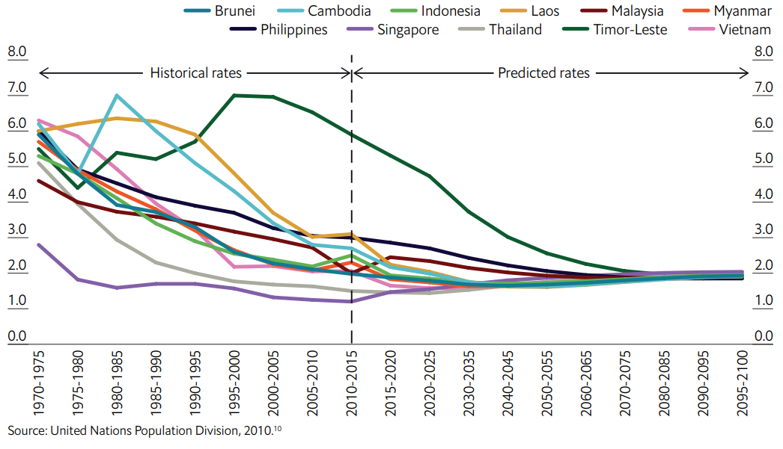
The fertility rate of Southeast Asia has drifted from 5.5 in 1970 down to 2.4 in 2015 and continues to fall
Total fertility rate of Southeast Asian countries from 1970 to 2100
(TFR; children per woman)
eiu.com/publicpolicy

Slide 4
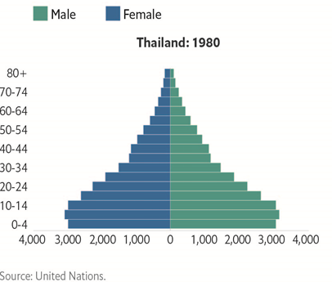
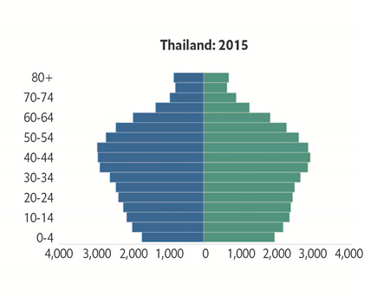
Thailand’s fertility rate is among the lowest in Southeast Asia, at 1.58
Population pyramid of Thailand
(in thousands)
eiu.com/publicpolicy

Slide 5



Rapid declines in fertility rates put pressure on countries’ workforce, healthcare cost, and family dynamics
The National Economic and Social Development Board projects that, between 2015 and 2035, Thailand's workforce, those aged 15-59 years old, will fall by about 6m to 37m.
The Lancet projects that Thailand’s national healthcare spending will rise from 4.1% of GDP in 2014 to 4.7% in 2040
Families will increasingly be pressured to care for both the young and the old, in absence of significant welfare support, adding pressure to working-age individuals.
eiu.com/publicpolicy

Slide 6
The fall is due to population policies, urbanisation, workforce participation, and socio-cultural changes
Regional focus on fertility reduction in the 1970s and 1980s and uneven responses in the following decades (e.g. Thailand’s National Family Planning Programme).
Population policies
Urbanisation
Southeast Asia has seen rapid urbanisation and development. This comes with higher cost of living and smaller dwellings.
Improvements in women’s education had increased female participation in the workforce, meaning that many women postpone childbirth in order to pursue economic opportunities.
Workforce participation
Socio-cultural changes
A shift from “quantity” to “quality” motivates the desire for a smaller family size.
eiu.com/publicpolicy

Slide 7
Governments are using three sets of policy levers to reverse population decline
Family friendly policies
Awareness and access
Financial relief
Tax reliefs and cash incentives for childbirth
Marriage and parenthood package
Subsidised child care
Housing subsidies
Health promotion programmes on factors affecting fertility
Education on fertility preservation, family planning
Relaxing population control and family planning
Maternity protection and parental leave entitlements as basic rights
Workplace regulations for work-life balance
eiu.com/publicpolicy

Slide 8




Four factors will play a key role in determining the impact of population dynamics in Southeast Asia
Migration
Replacement migration can provide countries of
destination with needed human resources and talent but it should be managed carefully to avoid social tensions.
Welfare systems
The economic impact of falling fertility rates and population ageing will depend on effective financial planning for retirement.
Changes in productivity
Declining population numbers have a negative impact on economic growth. However, automation and AI will play a role in determining the optimal size of the working population to sustain society.
Education and skills
An adequate demographic profile will need to be supplemented by the development of a workforce that has the right skills for the jobs of the future.
eiu.com/publicpolicy

Slide 9


Contact us
With 18 offices worldwide, EIU Public Policy is truly a global business.
Speak to one of our experts today:
Stefano Scuratti
Regional Director, APAC
stefanoscuratti@economist.com
London: +44 (0)20 7576 8000
Singapore: +65 6534 5177
New York: +1 212 541 0500
eiu_enquiries@eiu.com
eiu.com/publicpolicy

